Slide 1
Kiva Crowdfunding
Data Management For Analytics: Fall 2019
Group 20: Brittany Bishop, Xinshuang Wang, Sally Zhang, Tian Tian

Slide 2

How are the loans used?
Kiva.org is a crowdfunding platform which serves to extend financial services to poor and underserved populations across the globe.
Where in the world do these
loans end up being dispersed?
How does the gender of the borrower(s) relate to the various other aspects of the loan?

Slide 3
Original Data
672462 rows
20 columns
id | funded_amount | loan_amount | activity | sector | use | country_code | country | region | currency
653051 | 300 | 300 | Fruits & Vegetables | Food | To buy seasonal, fresh fruits to sell. | PK | Pakistan | Lahore | PKR
653053 | 575 | 575 | Rickshaw | Transportation | to repair and maintain the auto rickshaw used in their business. | PK | Pakistan | Lahore | PKR
653068 | 150 | 150 | Transportation | Transportation | To repair their old cycle-van and buy another one to rent out as a source of income | IN | India | Maynaguri | INR
partner_id | posted_time | disbursed_time | funded_time | term_in_ months | lender_count | tags | borrower_ genders | repayment_ interval | date
247 | 2014-01-01 06:12:39+00:00 | 2013-12-17 08:00:00+00:00 | 2014-01-02 10:06:32+00:00 | 12 | 12 |  | female | irregular | 1/1/2014
247 | 2014-01-01 06:51:08+00:00 | 2013-12-17 08:00:00+00:00 | 2014-01-02 09:17:23+00:00 | 11 | 14 |  | female, female | irregular | 1/1/2014
334 | 2014-01-01 09:58:07+00:00 | 2013-12-17 08:00:00+00:00 | 2014-01-01 16:01:36+00:00 | 43 | 6 | user_favorite, user_favorite | female | bullet | 1/1/2014
Missing Values
Repetitive Timestamps
Useless description variables

Slide 4
Clean and Wrangle
id | funded_amount | loan_amount | activity | sector | use | country_code | country | region | currency
653051 | 300 | 300 | Fruits & Vegetables | Food | To buy seasonal, fresh fruits to sell. | PK | Pakistan | Lahore | PKR
653053 | 575 | 575 | Rickshaw | Transportation | to repair and maintain the auto rickshaw used in their business. | PK | Pakistan | Lahore | PKR
653068 | 150 | 150 | Transportation | Transportation | To repair their old cycle-van and buy another one to rent out as a source of income | IN | India | Maynaguri | INR
partner_id | posted_time | disbursed_time | funded_time | term_in_ months | lender_count | tags | borrower_ genders | repayment_ interval | date
247 | 2014-01-01 06:12:39+00:00 | 2013-12-17 08:00:00+00:00 | 2014-01-02 10:06:32+00:00 | 12 | 12 |  | female | irregular | 1/1/2014
247 | 2014-01-01 06:51:08+00:00 | 2013-12-17 08:00:00+00:00 | 2014-01-02 09:17:23+00:00 | 11 | 14 |  | female, female | irregular | 1/1/2014
334 | 2014-01-01 09:58:07+00:00 | 2013-12-17 08:00:00+00:00 | 2014-01-01 16:01:36+00:00 | 43 | 6 | user_favorite, user_favorite | female | bullet | 1/1/2014
Delete useless columns
Delete missing values

Slide 5
Clean and Wrangle
id | funded_amount | loan_amount | activity | sector | country_code | country | currency | posted_time | term_in_ months
653051 | 300 | 300 | Fruits & Vegetables | Food | PK | Pakistan | PKR | 2014-01-01 06:12:39+00:00 | 12
653053 | 575 | 575 | Rickshaw | Transportation | PK | Pakistan | PKR | 2014-01-01 06:51:08+00:00 | 11
653068 | 150 | 150 | Transportation | Transportation | IN | India | INR | 2014-01-01 09:58:07+00:00 | 43
lender_count | borrower_ genders | male_count | female_count | gender_mix | repayment_ interval
12 | female | 0 | 1 | f | irregular
14 | female, female | 0 | 2 | f | irregular
6 | female | 0 | 1 | f | bullet
For each borrower group, count the number of either gender
Check whether the borrower group has only male, only female or both genders
Delete borrower_genders column, because all we need is the count number

Slide 6
Cleaned Data
631558 rows
15 columns
id | funded_amount | loan_amount | activity | sector | country_code | country | currency
653051 | 300 | 300 | Fruits & Vegetables | Food | PK | Pakistan | PKR
653053 | 575 | 575 | Rickshaw | Transportation | PK | Pakistan | PKR
653068 | 150 | 150 | Transportation | Transportation | IN | India | INR
posted_time | term_in_months | lender_count | male_count | female_count | gender_mix | repayment_interval
1/1/2014 1:12 | 12 | 12 | 0 | 1 | f | irregular
1/1/2014 1:51 | 11 | 14 | 0 | 2 | f | irregular
1/1/2014 4:58 | 43 | 6 | 0 | 1 | f | bullet
No missing value
No redundant variables
All data can be aggregated or counted

Slide 7
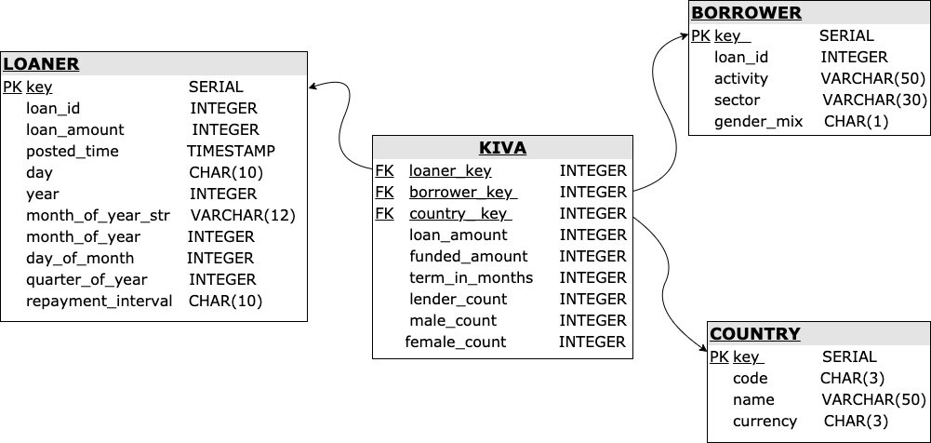
SCHEMA

Slide 8
Data Analysis – Question 1
How are these loans used? We found the top 10 sectors with the largest total loan amount and showed the frequency and average loan amount for each activity in these ten sectors.

Slide 9
Data Analysis – Question 2
Where are these loans going and when is the need highest? Find the 10 counties with the largest average loan amount and specify the month with the largest need.

Slide 10
Data Analysis – Question 3
How does the gender of the borrower(s) relate to the various other aspects of the loan? General exploration of the variables.

Slide 11
Thank you! Questions?

